Slide 1
100MW/100MWh BESS
Opportunity Evaluation
By Obed Sims

Slide 2
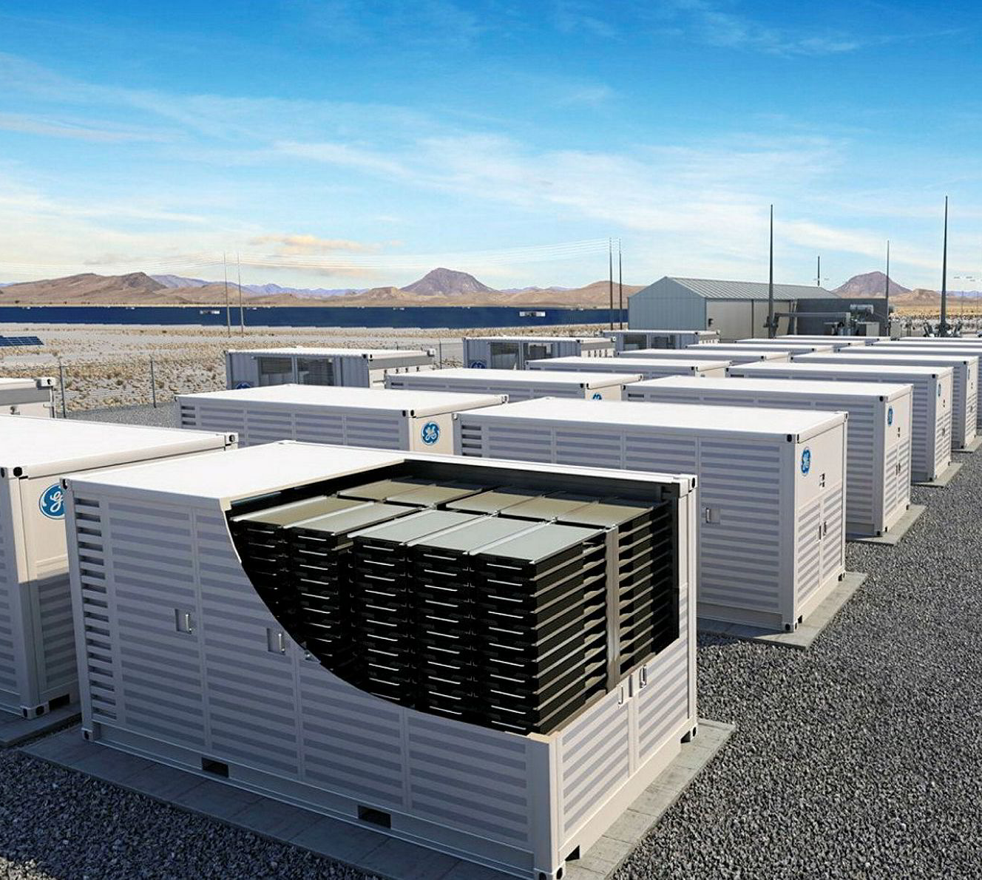
Opportunity Outline
Assumptions
100MW/100MWh Battery Energy Storage System
Round-trip efficiency of 85%
Average daily cycles (full charge and discharge) in each year are equal to 1
Backtesting on 8 years of day-ahead market data
Questions to be answered
Is buying 100 MWh of energy at the hour with the lowest price and selling 100 MWh of energy at the hour with the highest price an effective strategy? Is there a better alternative?
How does the average daily cycle limit affect battery revenues?
What recommendations can be made before moving forward with this opportunity?

Slide 3
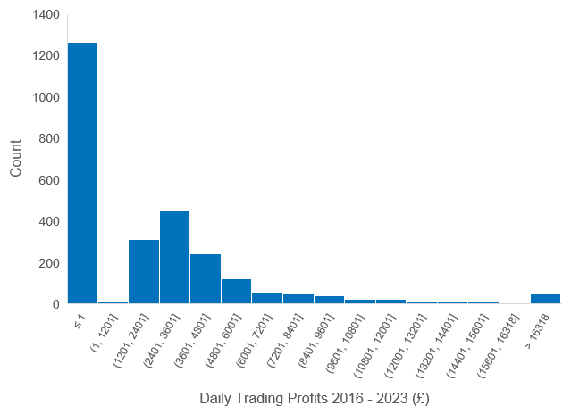
“The Boss’s” Arbitrage Trading Strategy
This strategy doesn’t factor the State of Charge of the BESS.
Whether a profit is made is dependent on the timings of the peak prices.
This strategy also assumes all forecasts will be perfect.
If this is a Li-ion chemistry, then it doesn’t factor the degradation and physical constraints.

Slide 4
Optimised Trading Strategy (OTS)
Uses an annual horizon optimisation based on the day-ahead power prices.
The advantages of the OTS is its ability to consider physical constraints.
In every year, the OTS yields greater profits than “The Boss’s” strategy.
Will continue to perform better than the “The Boss’s” strategy whilst reliable power price forecasts are available.

Slide 5
Daily Cycle Limit Impact
Based on the OTS, doubling the daily cycle limit results on average in a 11% increase in annual trading profits.
Don’t expect a doubling in trading profits as this is also dependent on the times of the power price spreads

Slide 6

Recommendations & Next Steps
Essential to analyse the impact of this trading strategy on battery degradation and physical constraints (e.g. thermal limits).
Carry out a cost-benefit analysis of implementing a longer duration battery – these are better suited to trading on the wholesale market. However, the longer the duration, the greater the CAPEX.
Look into stacking other revenue streams alongside arbitrage (e.g. ancillary services, TNUoS, DUoS, balancing mechanism).
Historical power price data may not be representative of future power prices. Trading returns are dependent on the quality of forecasts.
Determine the warranty conditions of the battery. Leniency on cycle limits will be advantageous, specifically for days with large price spreads and multiple peaks.

